Slide 1
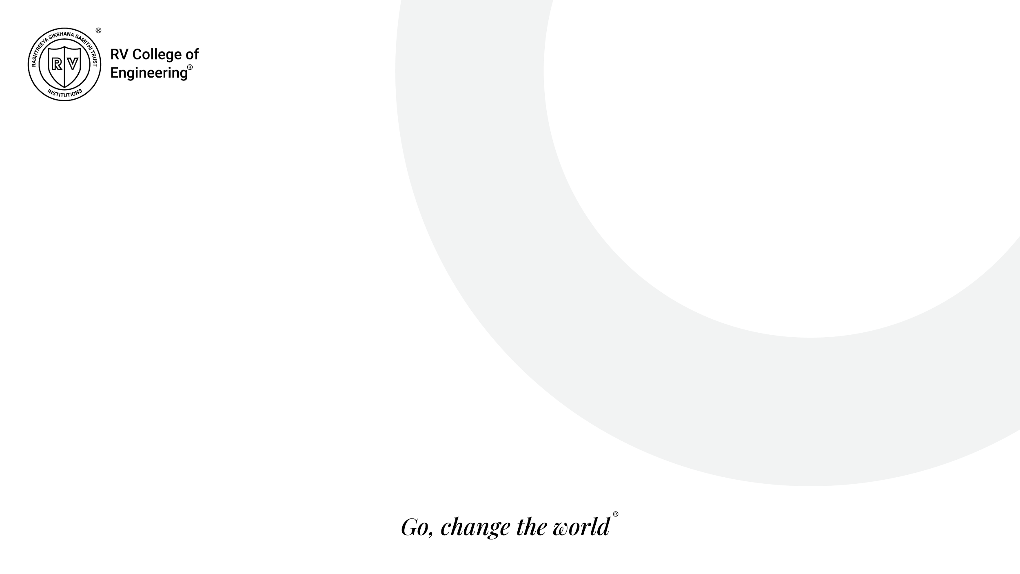
Design Thinking Department of ISE Phase I

Slide 2
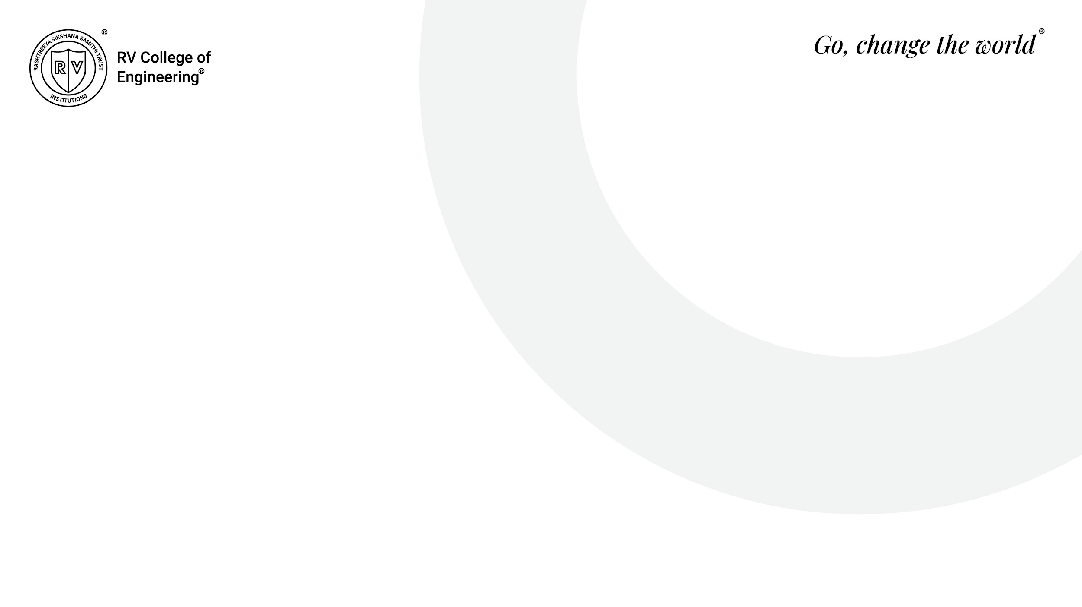
Team Members
Pratham Nilange - 1RV23IS091
Tanikonda Sai Karan - 1RV23IS129
Parthav Prathim M - 1RV23IS081
Sadhu Venkata Hemanth Sai - 1RV23IS100
Mentors

Slide 3
Title
Science Unlocked
Science Unlocked is an innovative educational project aimed at creating an online platform for studying science in chronological order so as to develop an intuitive understanding of the topics .

Slide 4
Motivation
Our motivation is that we have failed JEE mains and advanced.
We strive to develop an application that helps future students to develop the intuition behind important concepts of science so that they can understand important concepts and remember them better.
One of the most important motivating factors was the difficulty we had faced when learning new concepts during our preparations for competitive exams.
By showcasing key scientific discoveries and milestones, the website will enhance learners' understanding of the evolution of scientific thought.

Slide 5
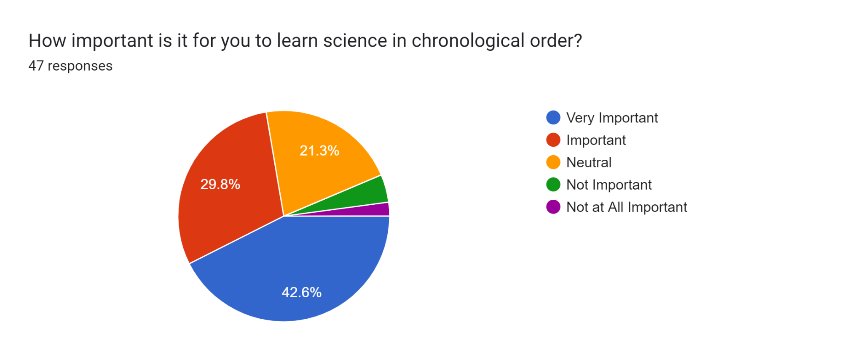
Empathy
Questionnaire
1

Slide 6
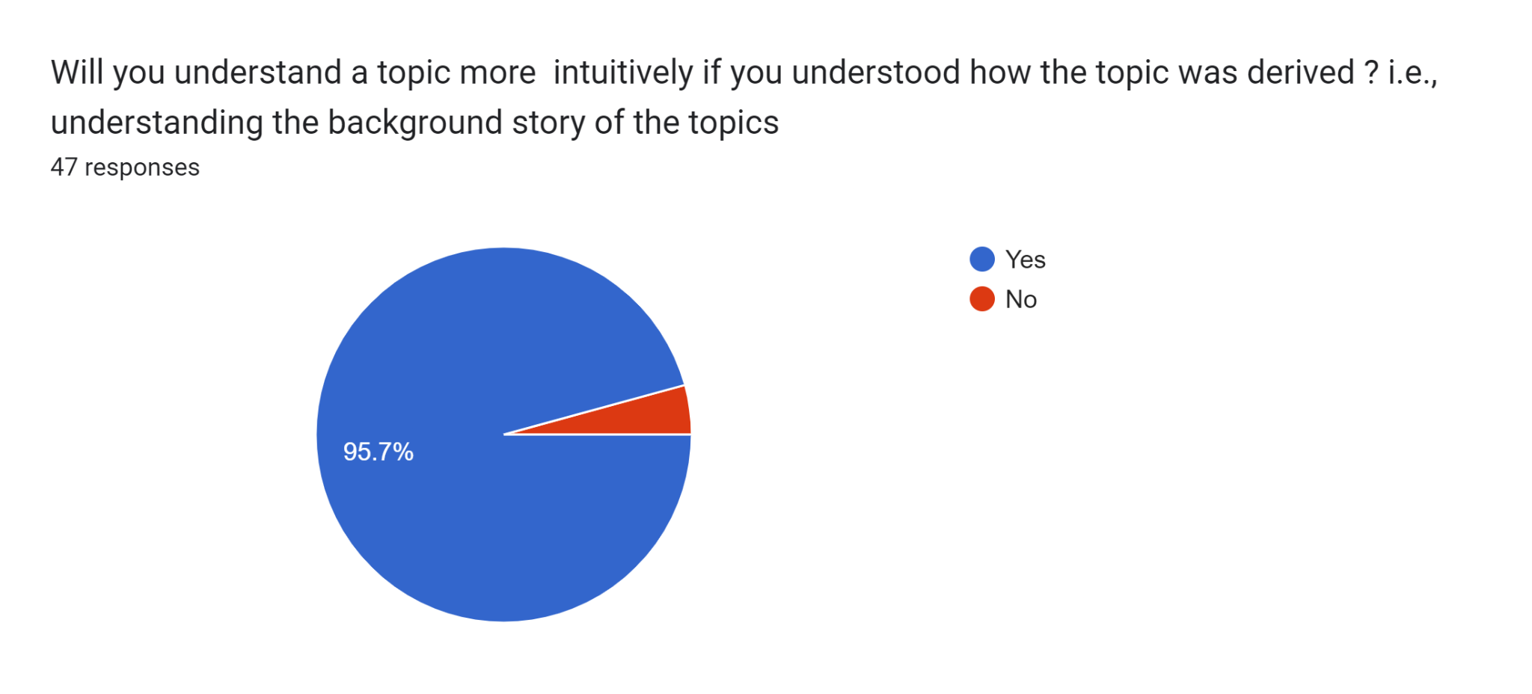
Empathy
Questionnaire
1
1

Slide 7
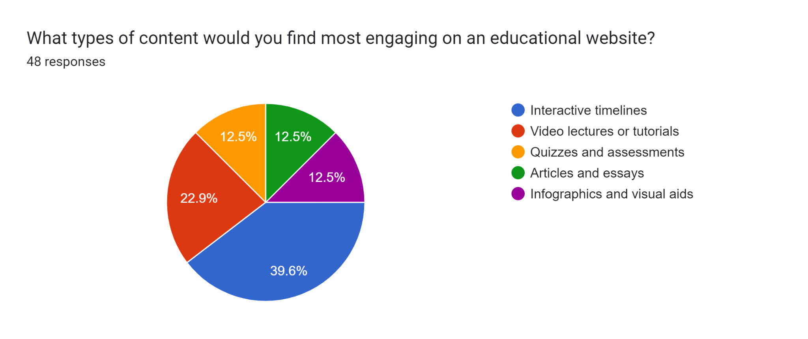
Empathy
Questionnaire
1
1

Slide 8
Empathy
Sample client details:
Educational Institutions
Individual Teachers
Online Educational Platforms
Base/End user :
Students
Educators
Parents

Slide 9
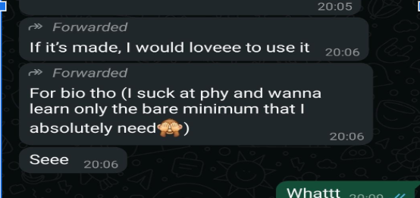
Empathy- Evidences

Slide 10
Empathy Map
User Persona: High School or Undergraduate Student Interested in Science
SAYS
"Science feels like a bunch of disconnected facts."
"I want to understand why things work, not just memorize them for exams."
"It’s hard to see how discoveries relate to modern science."
"Learning science could be more engaging and less overwhelming."
THINKS
"How can I improve my understanding of science without feeling lost?"
"What’s the best way to connect historical discoveries to today’s knowledge?"
"Am I learning in a way that prepares me for real-world applications?"
"A new, structured approach might make learning easier and more fun."

Slide 11
Empathy Map
FEELS
Frustrated by fragmented learning and rote memorization.
Overwhelmed by the complexity of scientific topics.
Curious about how discoveries shape modern life.
Excited by the prospect of a fresh, intuitive approach to science.
DOES
Searches for supplementary resources online (videos, articles, forums).
Engages with interactive tools or apps for better comprehension.
Discusses challenging concepts with peers or educators.
Seeks ways to apply theoretical knowledge in practical scenarios.

Slide 12
Problem Statement
Despite the abundance of online educational resources, learners often struggle to grasp the interconnected nature of scientific concepts and the chronological progression of scientific discoveries. Existing platforms frequently present fragmented information, making it challenging for students, educators, and science enthusiasts to understand how scientific ideas have evolved over time.
There is a need for a comprehensive, interactive platform that organizes scientific knowledge in a chronological and intuitive manner, showcasing key milestones and breakthroughs across disciplines. Such a resource would bridge gaps in understanding the historical and conceptual context of science while catering to diverse learning preferences.

Slide 13
Prototyping Tools and Technologies
PowerPoint or Google Slides
Basic tools for low-fidelity prototyping that can showcase the flow and layout of a design. Useful for quick visualizations and initial feedback without steep learning curves.
HTML (HyperText Markup Language) Used to structure the content of the web pages, including text, images, and multimedia elements. It forms the backbone of the platform's user interface.
CSS (Cascading Style Sheets) Defines the visual styling of the platform, such as layout, colors, fonts, and animations. It ensures the website is visually appealing and responsive across devices.
JavaScript Adds interactivity to the platform, such as clickable timelines, animations, and dynamic content updates. JavaScript is essential for creating a smooth and engaging user experience.
Python
Useful for backend development, including data processing, API integration, and server-side functionality. Python frameworks like Django or Flask can streamline development.

Slide 14
Expected Outcome
Science Unlocked will transform science education by presenting topics in a chronological sequence, helping learners intuitively understand the evolution of scientific knowledge. This approach will enable students to connect historical discoveries with modern applications, fostering critical thinking and curiosity.
By offering interactive content and real-world examples, the platform will enhance engagement and retention, moving beyond rote memorization to a deeper comprehension of concepts. Learners will develop an appreciation for the scientific process and the interconnectivity of ideas, empowering them to analyze, innovate, and contribute meaningfully to science. Science Unlocked aims to inspire confident, well-rounded, and informed learners.

Slide 15
References
1.Ditch That Textbook - Discusses innovative ways to use timelines in teaching, emphasizing the importance of historical context and narrative. The approach aligns with creating a sequence of scientific discoveries or concepts to enrich understanding while keeping students engaged​ - https://timepath.co/for-who/education
2.Timepath - A tool designed for creating interactive timelines in education, Timepath allows users to explore subjects dynamically, including quizzes and collaborative timeline creation. It highlights how visual sequencing can engage students and make learning more interactive and accessible - https://ditchthattextbook.com/5-lessons-to-teach-with-timelines/

